Slide 1
DIYALA UNIVERSITY COLLEGE OF ENGINEERING DEPARTMENT OF COMMUNICATION ENGINEERING
Electronic Circuits II
Second Year_ Lecture 4
lecturer
Wisam Hayder
2021

Slide 2
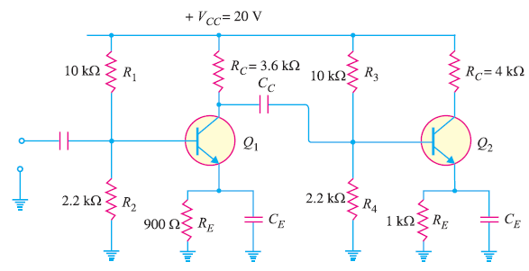
5. RC Coupled Transistor Amplifier
Homework
(1). Fig. 1, shows a 2-stage RC coupled amplifier. What is the biasing potential for the second stage ? If the coupling capacitor $C_{C}$ is replaced by a wire, what would happen to the circuit ?
Fig.1
Notes:
aaa

Slide 3
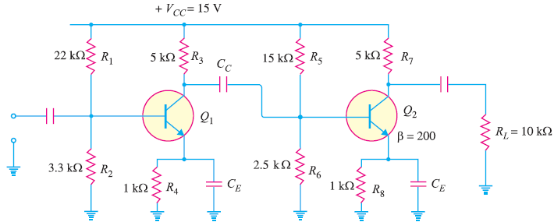
5. RC Coupled Transistor Amplifier
(2) Fig. 2, shows a 2-stage RC coupled amplifier. Find the voltage gain of (i) first stage (ii) second stage and (iii) overall voltage gain.
Fig.2
Notes:
aaa

Slide 4
6. Transformer-Coupled Amplifier
The main reason for low voltage and power gain of RC coupled amplifier is that the effective load (RAC) of each stage is decreased due to the low resistance presented by the input of each stage to the preceding stage.
If the effective load resistance of each stage could be increased, the voltage and power gain could be increased.
This can be achieved by transformer coupling.
Notes:
aaa

Slide 5
6. Transformer-Coupled Amplifier
By the use of impedance-changing properties of transformer, the low resistance of a stage (or load) can be reflected as a high load resistance to the previous stage.
Transformer coupling is generally employed when the load is small.
It is mostly used for power amplification.
Notes:
aaa

Slide 6
6. Transformer-Coupled Amplifier
Fig. 3 shows two stages of transformer coupled amplifier.
A coupling transformer is used to feed the output of one stage to the input of the next stage.
The primary P of this transformer is made the collector load and its secondary S gives input to the next stage.
Notes:
aaa

Slide 7
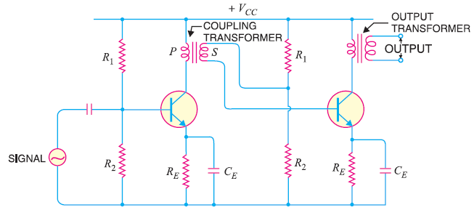
6. Transformer-Coupled Amplifier
Fig. 3
Notes:
aaa

Slide 8
6. Transformer-Coupled Amplifier
Operation. When an a.c. signal is applied to the base of first transistor, it appears in the amplified form across primary P of the coupling transformer.
The voltage developed across primary is transferred to the input of the next stage by the transformer secondary as shown in Fig.3.
The second stage renders amplification in an exactly similar manner.
Notes:
aaa

Slide 9
6. Transformer-Coupled Amplifier
Frequency response
The frequency response of a transformer coupled amplifier is shown in Fig.4.
It is clear that frequency response is rather poor i.e. gain is constant only over a small range of frequency.
The output voltage is equal to the collector current multiplied by reactance of primary.
At low frequencies, the reactance of primary begins to fall, resulting in decreased gain.
Notes:
aaa

Slide 10
6. Transformer-Coupled Amplifier
At high frequencies, the capacitance between turns of windings acts as a bypass condenser to reduce the output voltage and hence gain.
It follows, therefore, that there will be disproportionate amplification of frequencies in a complete signal such as music, speech etc.
Hence, transformer-coupled amplifier introduces frequency distortion.
Notes:
aaa

Slide 11
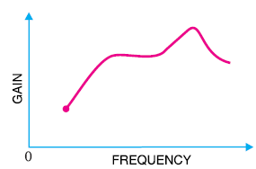
6. Transformer-Coupled Amplifier
It may be added here that in a properly designed transformer, it is possible to achieve a fairly constant gain over the audio frequency range.
But a transformer that achieves a frequency response comparable to RC coupling may cost 10 to 20 times as much as the inexpensive RC coupled amplifier.
Fig. 4
Notes:
aaa

Slide 12
6. Transformer-Coupled Amplifier
Advantages
(i) No signal power is lost in the collector or base (ii) An excellent impedance matching can be achieved in a transformer coupled amplifier. It is easy to make the inductive reactance of primary equal to the output impedance of the transistor and inductive reactance of secondary equal to the input impedance of next stage. (iii) Due to excellent impedance matching, transformer coupling provides higher gain. As amatter of fact, a single stage of properly designed transformer coupling can provide the gain of two stages of RC coupling.
Notes:
aaa

Slide 13
6. Transformer-Coupled Amplifier
Disadvantages
(i) It has a poor frequency response i.e.the gain varies considerably with frequency.
(ii) The coupling transformers are bulky and fairly expensive at audio frequencies.
(iii) Frequency distortion is higher i.e. low frequency signals are less amplified as compared to the high frequency signals.
(iv) Transformer coupling tends to introduce hum in the output.
Notes:
aaa

Slide 14
6. Transformer-Coupled Amplifier
Applications
Transformer coupling is mostly employed for impedance matching.
In general, the last stage of a multistage amplifier is the power stage.
Here, a concentrated effort is made to transfer maximum power to the output device e.g. a loudspeaker.
For maximum power transfer, the impedance of power source should be equal to that of load.
Notes:
aaa

Slide 15
6. Transformer-Coupled Amplifier
Usually, the impedance of an output device is a few ohms whereas the output impedance of transistor is several hundred times this value.
In order to match the impedance, a step-down transformer of proper turn ratio is used.
The impedance of secondary of the transformer is made equal to the load impedance and primary impedance equal to the output impedance of transistor.
Notes:
aaa

Slide 16
6. Transformer-Coupled Amplifier
Fig. 5 illustrates the impedance matching by a step down transformer.
The output device (e.g. speaker) connected to the secondary has a small resistance RL.
The load R′L appearing on the primary side will be:
Notes:
aaa

Slide 17
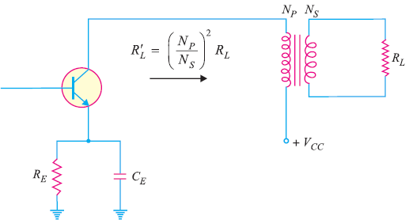
6. Transformer-Coupled Amplifier
For instance, suppose the transformer has turn ratio $N_{P}$: $N_{S}$ :: 10 : 1. If $R_{L}$ = 100 Ω , then load appearing on the primary is :
Fig. 5
Notes:
aaa

Slide 18
6. Transformer-Coupled Amplifier
Thus the load on the primary side is comparable to the output impedance of the transistor.
This results in maximum power transfer from transistor to the primary of transformer.
This shows that low value of load resistance (e.g. speaker) can be “stepped-up” to a more favourable value at the collector of transistor by using appropriate turn ratio.

Slide 19
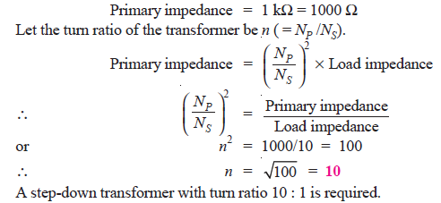
6. Transformer-Coupled Amplifier
Ex 1. A transformer coupling is used in the final stage of a multistage amplifier. If the output impedance of transistor is 1kΩ and the speaker has a resistance of 10 Ω , find the turn ratio of the transformer so that maximum power is transferred to the load.
Sol:
For maximum power transfer, the impedance of the primary should be equal to the output impedance of transistor and impedance of secondary should be equal to load impedance i.e.

Slide 20
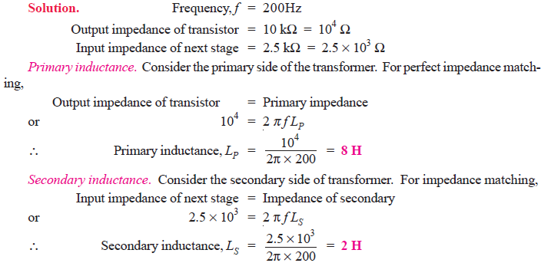
6. Transformer-Coupled Amplifier
Ex 2. A transistor uses transformer coupling for amplification. The output impedance of transistor is 10 kΩ while the input impedance of next stage is 2.5 k Ω . Determine the inductance of primary and secondary of the transformer for perfect impedance matching at a frequency of 200 Hz.
20

